Slide 1
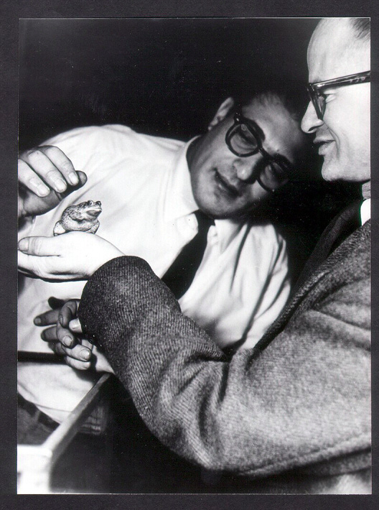

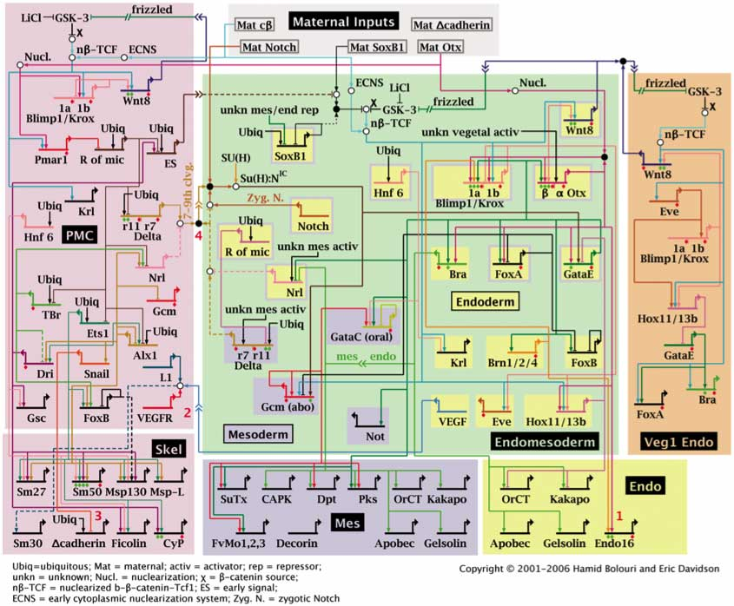
MCB 135 Lecture 3 Turing completeness in living systems Self-replication and the role of tape
Notes:
Walter Pitts, John von Neumann

Slide 2
Recap: What is Turing completeness?
S
M
Q
P
c
The ability to compute any function a Turing machine could compute, that is, anything that could be calculated by mechanical means*.
*as far as we know, see Church-Turing thesis.
Notes:
As far as we know, Turing machines can compute anything that can be computed by mechanical/algorithmic means.

Slide 3
Recap: proving Turing completeness
A system is Turing complete if:
It can implement any Boolean function
This will be true if it can implement NAND gates
It has unlimited memory
NAND
Notes:
Walter Pitts and Johnny von Neumann

Slide 4
Today’s Outline
Turing completeness of neurons
Signal transmission
The “artificial neuron” and Boolean functions
Memory storage
The fundamental characteristics of life
von Neumann’s “universal constructor”
Turing completeness of gene regulation

Slide 5
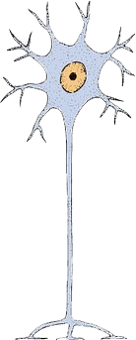
Anatomy of the neuron
Dendrites
Axon
Synapse
Direction of transmission
Notes:
At the synapse, the axon of the upstream neuron released neurotransmitters, which diffuse across the gap and bind to the dendrites of the downstream neuron, where they can either excite or inhibit it.
Within the neuron itself, the signal is transmitted in the form of changing ion concentrations which we can track by monitoring the membrane potential.

Slide 6
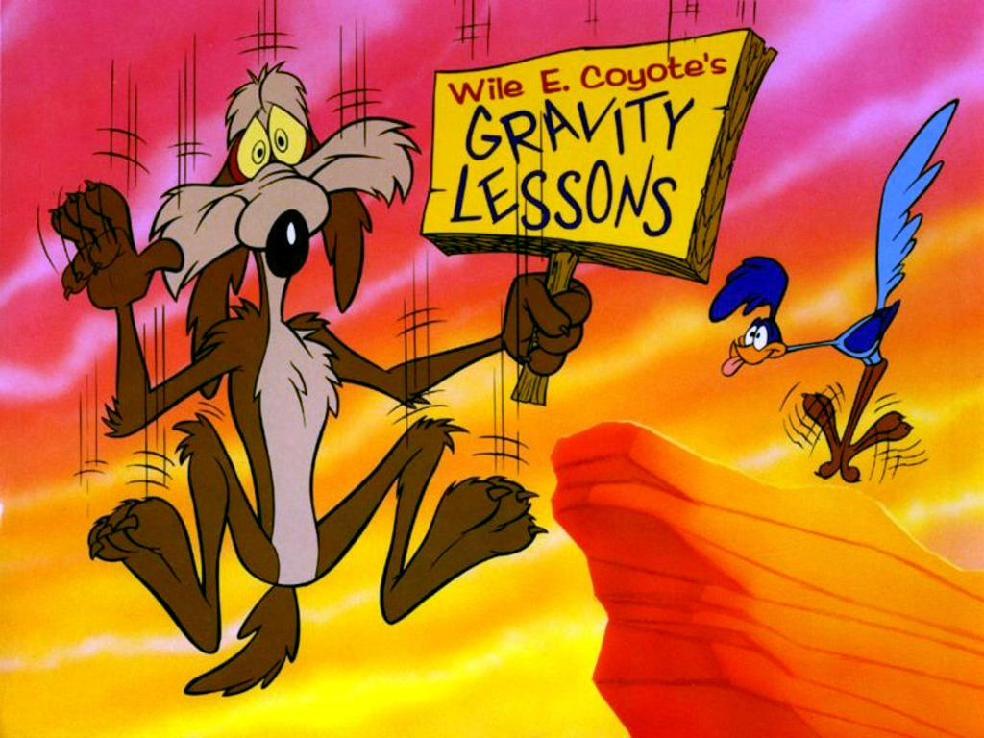
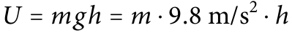
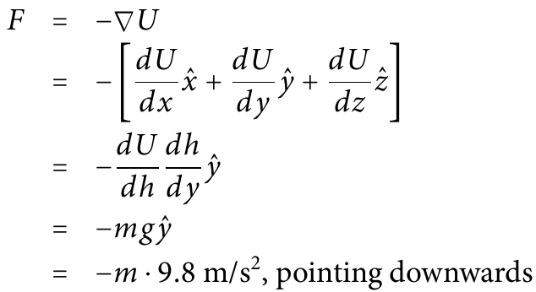
Many forces have an associated potential
Example: Gravity
Gravitational potential (energy)
Gravitational force
y
h
x
z
Notes:
This approximation applies near the Earth’s surface.
Notice that the potential doesn’t have a direction. The force of gravity does have a direction, of course: downward! The force always points in the direction where the potential is decreasing fastest. For gravity, near Earth’s surface, the potential decreases when height decreases. Therefore gravity points down.
To calculate the force from the potential, we need to take the gradient of the potential, which is defined as… You can see that the force will have a direction because each term in the gradient points in the x, y, or z direction. We know that U does not depend vary as we move in the x or z directions, so those two derivatives are zero, which leaves just this term. To calculate it, we apply the [ask audience which rule is that] chain rule.

Slide 7
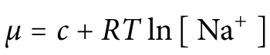
Chemical potential differences drive ions to regions of lower concentration
Na⁺ ions
Outside
Inside
Notes:
Although this formula for chemical potential may be unfamiliar to you, we can see right away that it meets our intuition. The force on the ions will push them in the direction where potential is decreasing. The potential decreases when the concentration of ions goes down. Therefore the force pushes the ions toward regions of lower concentration.

Slide 8
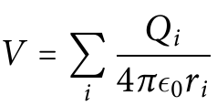
Electric potential differences drive ions toward opposite charges
Na⁺ ions
Proteins, phosphates, etc.⁽⁻⁻⁻⁻⁾
Outside
Inside
Notes:
We know that positively-charged things like sodium ions like to move towards negatively-charged things. It turns out that on the whole, the inside of the neuron normally has a net negative charge. This is because of all of the phosphate groups and proteins inside the cell (proteins can have both negative and positive charges, but they tend to be more negatively-charged overall). If the charge on the protein is negative, Q_i is negative. So, the potential will be decreasing as r decreases. An electric force will push the positively-charged ion toward the negatively-charged molecule so that r will decrease.

Slide 9
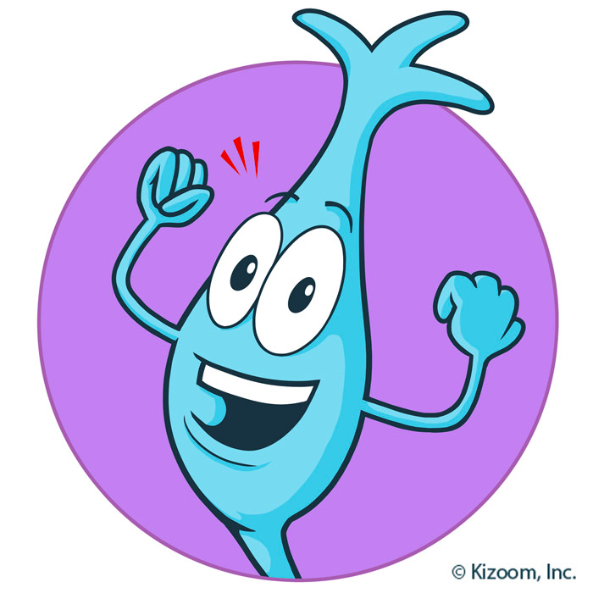
How neurons get excited

Slide 10
We’ll focus in on the membrane of the receiving dendrite
Synapse
Receiving dendrite
Notes:
At the synapse, the axon of the upstream neuron released neurotransmitters, which diffuse across the gap and bind to the dendrites of the downstream neuron, where they can either excite or inhibit it.
Within the neuron itself, the signal is transmitted in the form of changing ion concentrations which we can track by monitoring the membrane potential.

Slide 11
The neuron at rest
Na⁺ ions
Negatively-charged things
K⁺ ions
Outside
Inside
V_{m} = V_{in} – V_{out} = -70 mV

Slide 12
Excitatory neurotransmitter binding causes Na⁺ channels to open
Na⁺ ions
Negatively-charged things
K⁺ ions
Outside
Inside

Slide 13
The neuron depolarizes as Na⁺ flow in
Na⁺ ions
Negatively-charged things
K⁺ ions
Outside
Inside
V_{m} = V_{in} – V_{out} =
+ 30 mV

Slide 14
After a delay, Na⁺ channels close and voltage-gated K⁺ channels open
Na⁺ ions
Negatively-charged things
K⁺ ions
Outside
Inside
Notes:
Note that the neurotransmitter concentration eventually goes back down.

Slide 15
After a delay, Na⁺ channels close and voltage-gated K⁺ channels open
Na⁺ ions
Negatively-charged things
K⁺ ions
Outside
Inside
V_{m} = V_{in} – V_{out} =
-80 mV

Slide 16
K⁺ channels close and pumps (not shown) exchange Na⁺ and K⁺ to return the neuron to rest
Na⁺ ions
Negatively-charged things
K⁺ ions
Outside
Inside
V_{m} = V_{in} – V_{out} = -70 mV

Slide 17
Recap: Excitation in neurons
Na⁺ channels bind neurotransmitter and Na⁺ begins to flow in. V_{m} rises.
Higher V_{m} triggers voltage-gated K⁺ channels to open. K⁺ begins to flow out.
Around the same time, the neurotransmitter concentration decreases causing Na+ channels to close. V_{m} falls.
K+ channels eventually close, and the original ion concentrations are restored by pumps.

Slide 18
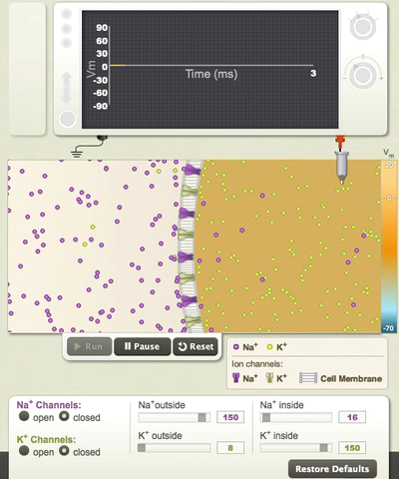
SimBio
Notes:
This animation is not ideal because the initial membrane voltage is zero instead of -70 mV, but you will still be able to see the initial rise in membrane voltage followed by a subsequent drop.
To recap:
Na+ channels bind neurotransmitter and Na+ begins to flow into the cell. The membrane potential rises.
The rising membrane potential triggers voltage-gated K+ channels to open. Potassium ions begin to leave.
Around the same time, the neurotransmitter concentration decreases

Slide 19
Inhibitory signals lower V_{m} instead
Na⁺ ions
Negatively-charged things
K⁺ ions
Outside
Inside

Slide 20
Inhibitory signals lower V_{m} instead
Na⁺ ions
Negatively-charged things
K⁺ ions
Outside
Inside
V_{m} = V_{in} – V_{out} = -80 mV

Slide 21
Excitatory and inhibitory signals alter V_{m} in the dendrites. What determines whether the neuron “fires?”

Slide 22
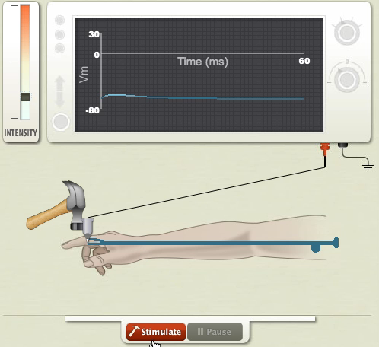
A neuron “fires” when a change in V_{m} travels down the axon
SimBio

Slide 23
Inhibitory and excitatory signals cause V_{m} changes in dendrites
Excitatory signal:
ΔV_{m} = +20
Inhibitory signal:
ΔV_{m} = -10
Each synapse may have a different strength (which can be regulated)

Slide 24
Ions diffuse down the dendrites, effectively “summing” membrane voltage changes near the base of the axon
Net signal:
ΔV_{m} = +10

Slide 25
The axon has voltage-gated Na⁺ (and K⁺) channels
If this spot (the axon hillock)
depolarizes enough , the whole axon will depolarize
Neuronal firing is an all-or-none response
…and since inputs represent a previous neuron’s firing, inputs are also all-or-none!

Slide 26
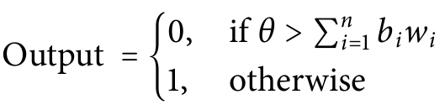
The “artificial neuron”
w₁
A threshold, θ
(required depolarization at axon hillock for firing)
b₁
w₂
b₂
As many Boolean inputs as you like
(correspond to synapses on dendrites)
Each input b_{i} has a weight, w_{i}
(correspond to synapse strength and type)
θ
One Boolean output
(axon firing)
…
b_{n-1}
w_{n-1}
b_{n}
w_{n}
Notes:
The inputs represent all of the synapses on the dendrites.
Weights represent the strength of the synapses as well as whether they are inhibitory are excitatory (the weights can be positive or negative). The threshold represents the membrane depolarization at the axon hillock that’s required for the neuron to fire and is also considered to be tunable.

Slide 27
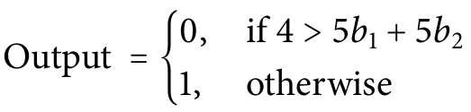
Example: an OR gate
w₁= 5
θ=4
The “OR” gate
w₂= 5
Input1 Input2 Weighted sum Output
0 0 0 0
1 0 5 1
0 1 5 1
1 1 10 1
Notes:
The inputs represent all of the synapses on the dendrites.
Weights represent the strength of the synapses as well as whether they are inhibitory are excitatory (the weights can be positive or negative). The threshold represents the membrane depolarization at the axon hillock that’s required for the neuron to fire and is also considered to be tunable.

Slide 28
Your turn: a NAND gate
w₁= ?
θ=?
w₂= ?
Input1 Input2 Weighted sum Output
0 0 ? 1
1 0 ? 1
0 1 ? 1
1 1 ? 0
Notes:
Use a negative threshold and two negative weights which together are less than the threshold.
Is it possible to have a neuron that fires constantly except when a signal is present? Yes, in fact this is the usual case for photoreceptors.

Slide 29
Neural systems can implement any Boolean function, since they can implement NAND gates. But do they have memory?
Yes: the strength of each synapse can be modified through use or disuse.
Notes:
How does this work? Depolarization at the synapse can be detected and used to control how often ion channels are added or removed there.

Slide 30
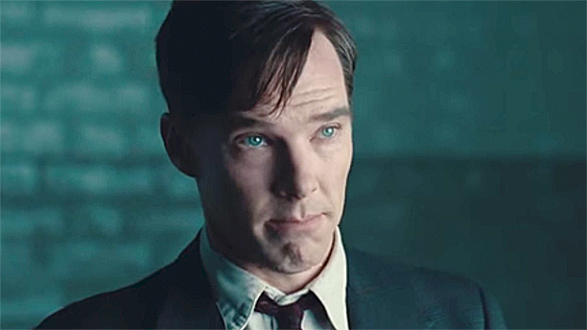
Neural systems are Turing complete …but what about the rest of biology?
Notes:
I wanted a look of pleasant surprise….but that’s as close as you can get with a British person.

Slide 31
We would need to prove Turing completeness in one of the fundamental qualities of living things …but what are they?

Slide 32
According to Wikipedia
Homeostasis
(Cellular) organization
Metabolism
Growth
Adaptation
Response to stimuli
Reproduction

Slide 33
According to Wikipedia
Homeostasis
(Cellular) organization
Metabolism
Growth
Adaptation
Response to stimuli
Reproduction

Slide 34
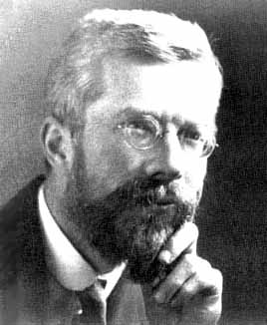
Self-reproduction with error is sufficient for adaptation
R. A. Fisher’s 1930
Fundamental Theorem of Natural Selection:
“The rate of increase in fitness of any organism is equal to its genetic variance in fitness.”

Slide 35
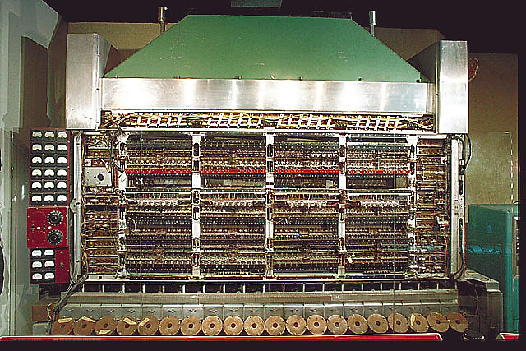
Johnny von Neumann
Notes:
Minimax and Mutually Assured Destruction
Like Alan Turing, Johnny von Neumann started out life as a pure mathematician. His father forced him to also study something more practical: he chose chemical engineering. He was a major figure at Princeton’s Institute of Advanced Study almost from the time of its founding (1933), where he worked alongside Albert Einstein and Wolfgang Pauli. He made contributions to set theory, measure theory, quantum mechanics, game theory, and statistics. And then the war came. Johnny’s expertise in physics and chemical engineering led him into development of atomic bomb (and later the hydrogen bomb). Understanding what occurred early in the explosion required trying out more combinations of parameters than human hands could handle. And that’s how Johnny became involved, in a very practical sense, designing computers. Johnny knew that the computers he developed were Turing complete – the description of the Turing machine having been published in 1939 but he also wondered whether electronic computers would be capable not just of computing anything, but also of replicating themselves.

Slide 36
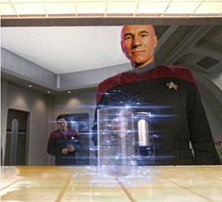
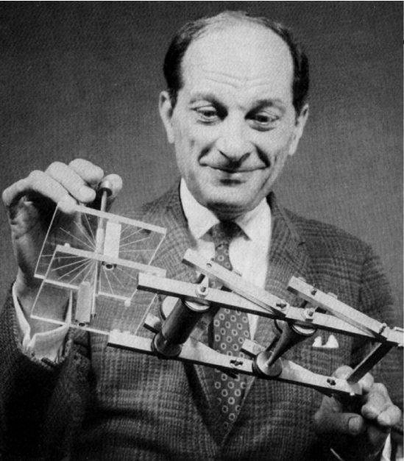
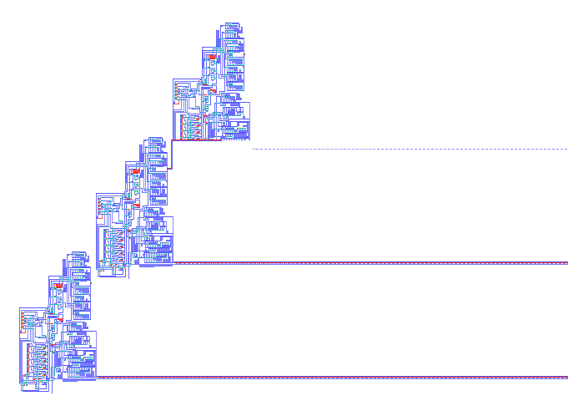
von Neumann’s Universal Constructor
Stan Ulam
Notes:
Stan Ulam, another major figure in the development of the h-bomb, counseled Johnny to try to build his self-replicating computer not out of mechanical parts but within a cellular automaton similar to the Game of Life. In fact, Johnny’s automaton wasn’t just capable of copying itself, it could copy anything. He called it a universal constructor.

Slide 37
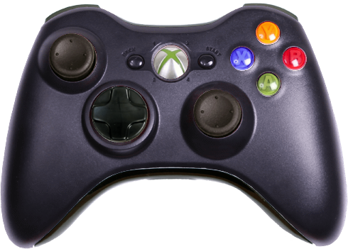
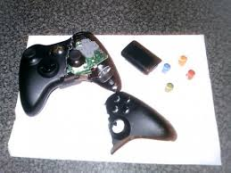
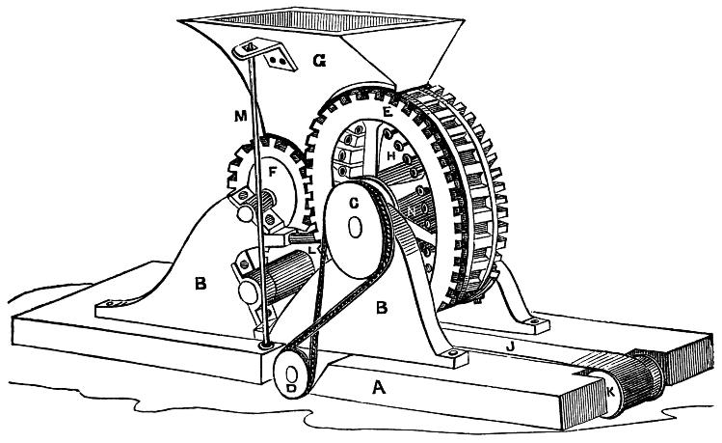
How would you design a constructor?

Slide 38
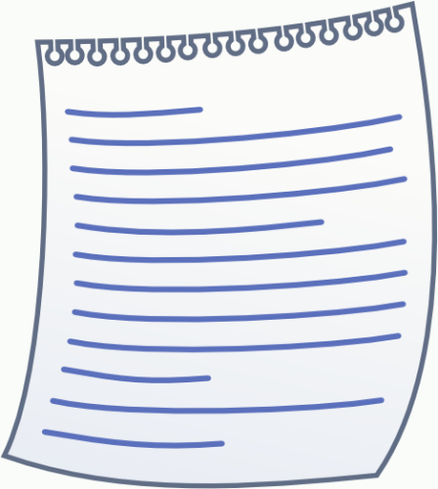
How would you design a constructor?

Slide 39
With the right instructions, a universal constructor is also a self-replicator

Slide 40
Some of von Neumann’s inspiration
Turing machines (1936)
S
M
Q
P
c
Avery, MacLeod, and McCarty (1941)
Showed that DNA was the hereditary material

Slide 41
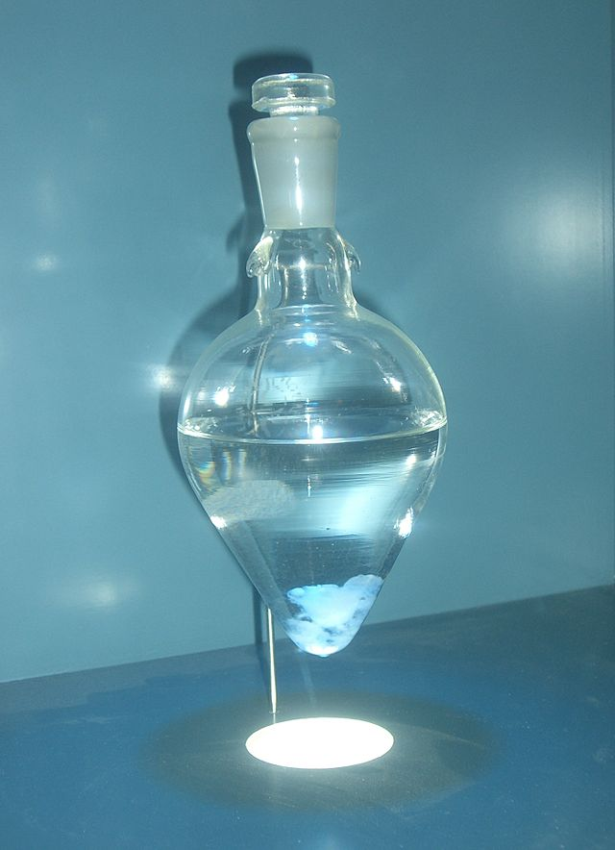
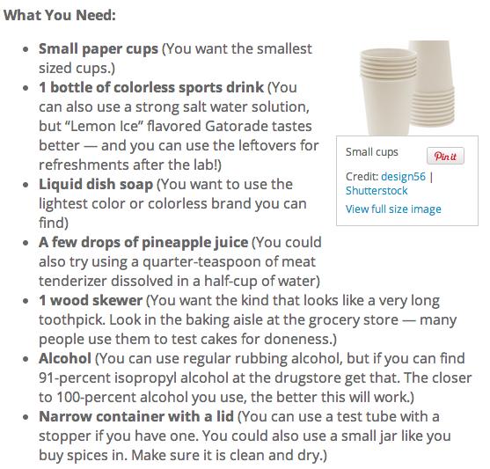
Avery-MacLeod-McCarty experiment
Try it at home!
Purified
DNA

Slide 42
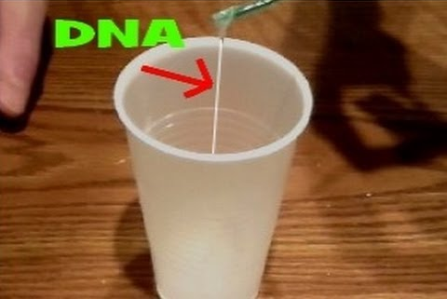
Avery-MacLeod-McCarty experiment
Try it at home!
Purified
DNA

Slide 43
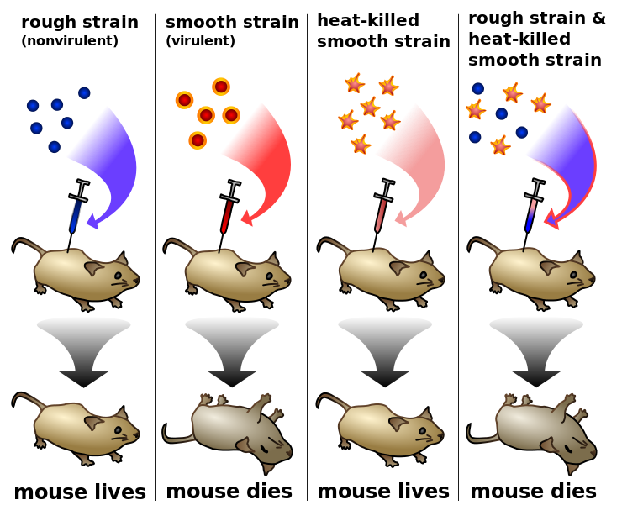
Avery-MacLeod-McCarty experiment
DNA from
Purified
DNA
Notes:
Unfortunately not everything transforms as easily as bacteria do, so the experiment could not be replicated in many other species and was for a while considered a curiosity.

Slide 44
The Central Dogma
Replication
(done by proteins)
DNA
Transcription
(done by proteins)
RNA
Translation
(done by RNA and proteins)
Protein

Slide 45
The Central Dogma: extended edition
Replication
(done by proteins)
DNA
Reverse transcription
(done by proteins)
Transcription
(done by proteins)
RNA
Translation
(done by RNA and proteins)
Protein

Slide 46
Self-reproduction requires interpreting instructions encoded in DNA (gene expression). If we can show that gene expression is Turing complete, then all biological systems are Turing complete.

Slide 47
What you absolutely must know about regulation of gene expression

Slide 48
Gene regulation occurs at all levels
Replication
How often gene transcription begins
How long transcription takes
How fast the mRNA gets degraded or diluted
How often translation of the mRNA begins
How long translation takes
How often the protein folds into a functional form
How often the protein is modified to activate or deactivate it
How fast the protein gets degraded or diluted
…even, how many copies of the encoding DNA are present
DNA
Transcription
RNA
Translation
Protein

Slide 49
Gene regulation occurs at all levels
Replication
How often gene transcription begins
How long transcription takes
How fast the mRNA gets degraded or diluted
How often translation of the mRNA begins
How long translation takes
How often the protein folds into a functional form
How often the protein is modified to activate or deactivate it
How fast the protein gets degraded or diluted
…even, how many copies of the encoding DNA are present
DNA
Transcription
RNA
Translation
Protein

Slide 50
Regulation of transcription initiation
The “promoter”
Codes for the protein
Transl. Start
Transl. Stop
What we want to transcribe
RNA polymerase
Notes:
The specifics of this process are different in the major domains of life, but the main problem is the same. There are a lot of places where transcription could start and only a few that are appropriate. We need to make sure that transcription begins in the right place.
Where should transcription start? Now, in general, RNA polymerase can bind at that site of its own accord.

Slide 51
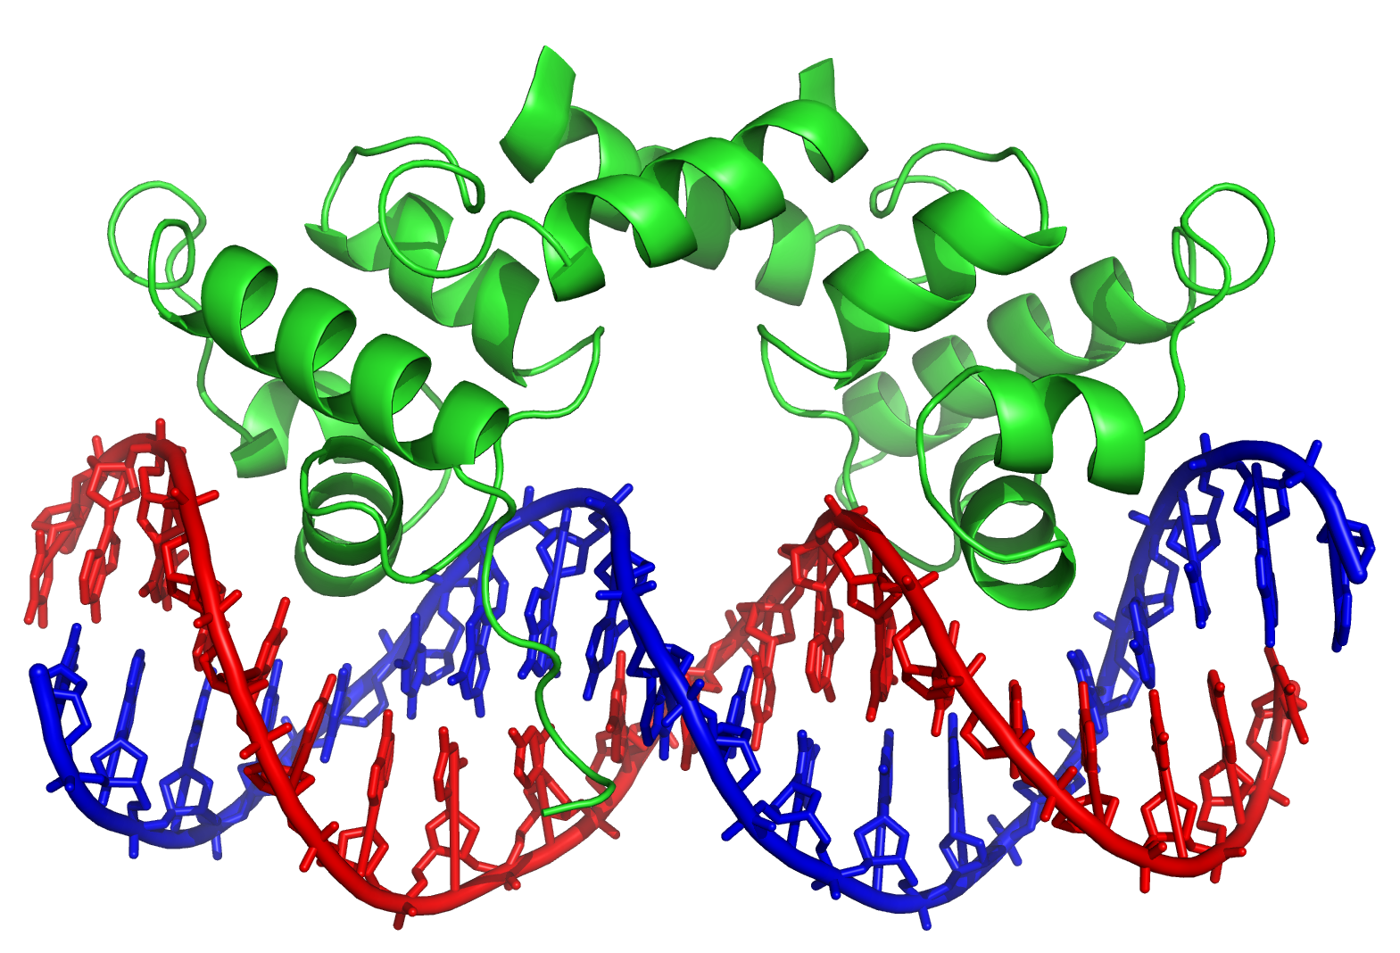
Transcription factors help position RNA polymerase
Transcription factors that bind RNA polymerase can help recruit it
RNA polymerase
Transl. Start
Transl. Stop
Transcription factor
Transcription factors can also prevent RNA polymerase from binding
?
TACCTCTGGCGGTGATA
ATGGAGACCGCCACTAT
Transl. Start
Transl. Stop
Transcription factor
Notes:
RNA polymerase forgot to call “seatbacks”
Lambda repressor is shown

Slide 52
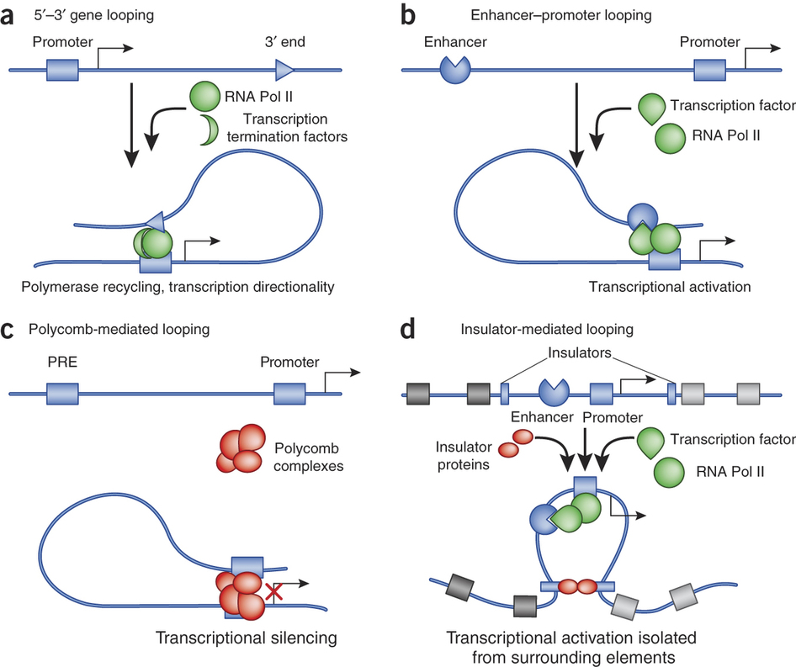
Transcription factors can also inhibit or promote transcription from a distance

Slide 53
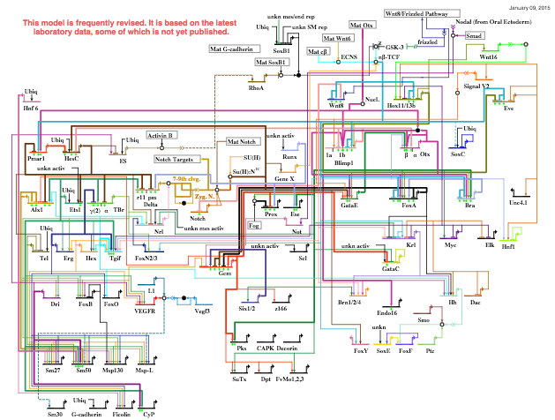
Natural gene regulatory networks can be very complex

Slide 54
Can we make NAND gates?
First, need to define “ON” and “OFF” for gene regulation.
Try transcription factor concentration ( [TF] ):
[TF] = 0 → binding site not occupied
[TF] >> 0 → binding site occupied
Tempting to set a threshold in between to make quasi-continuous concentrations into Boolean variables.

Slide 55
Binding site occupancy is probabilistic
The TF finds its binding site through a random search
A 1 nm protein in a >1 μm cell
A small site in 10⁶-10⁹ bp of DNA
# of copies of TF may be small
Time-consuming: similar DNA sequences are “almost as good”
Once arrived, TF could fall off again
By chance, or
Pushed aside -- at least as often as DNA is replicated
RNA polymerase faces related issues
Probability bound
[TF]
What we want
What we (might) get

Slide 56
Can we make NAND gates?
First, need to define “ON” and “OFF” for gene regulation.
Try transcription factor concentration ( [TF] ):
[TF] = 0 → binding site not occupied
[TF] >> 0 → binding site occupied
Tempting to set a threshold in between to make quasi-continuous concentrations into Boolean variables.
Probabilistic binding at intermediate concentrations will cause noise: gene expression when there should not be, and vice versa.

Slide 57
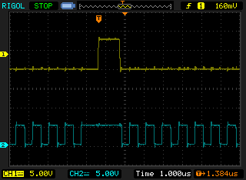
Your computer encodes Boolean values as high and low voltages (often 5V and 0V).
Voltage is a continuous quantity.
To get from high to low, or vice versa, must go through every value in between.
Why don’t the transitions cause problems for the computer?
Notes:
See if we can get students to say that the computer has a clock. (If not, lead them with, “When we say that a processor has a certain number of gigahertz, what does that mean?”)

Slide 58
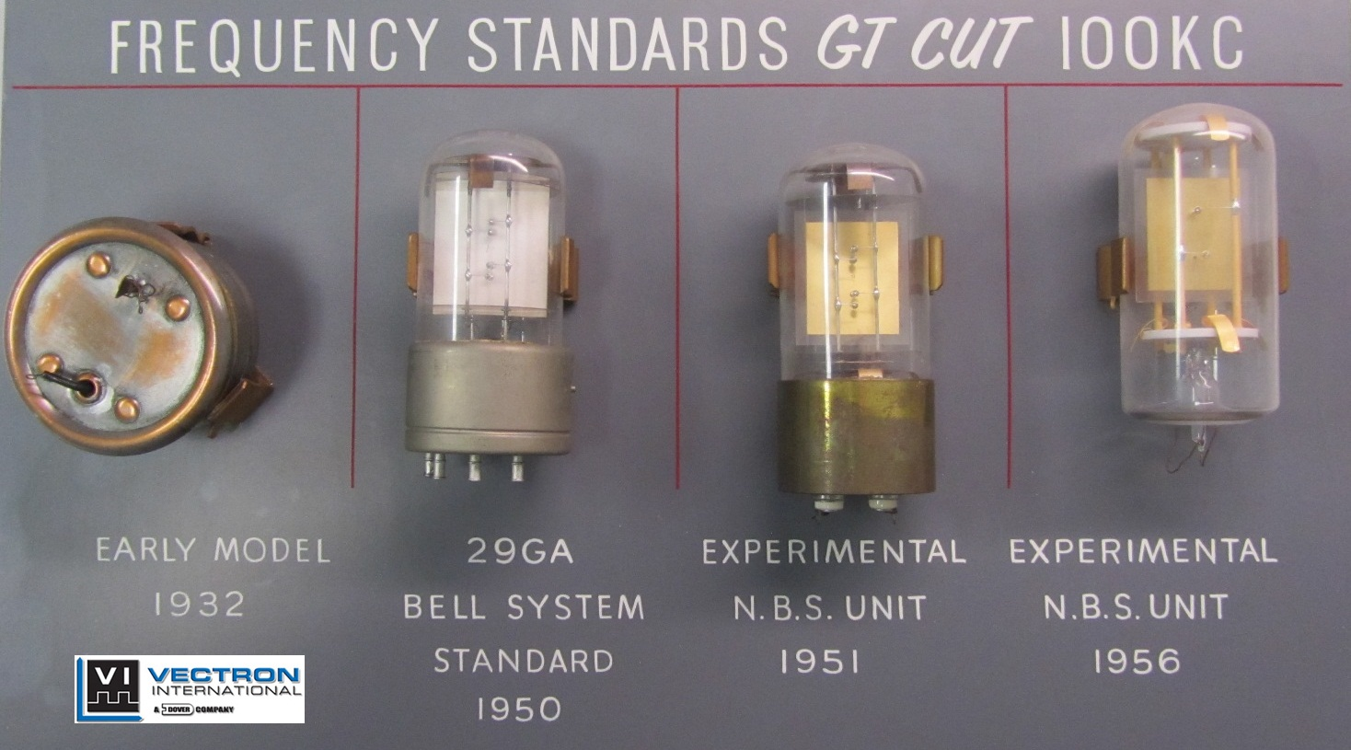
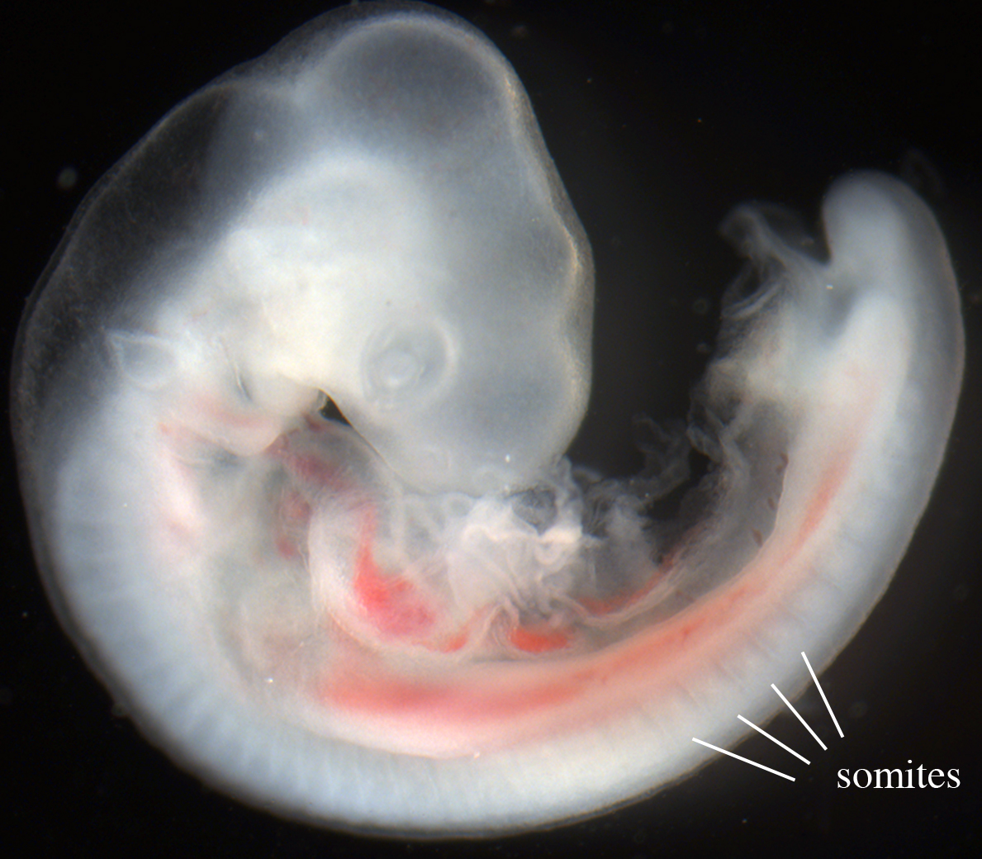
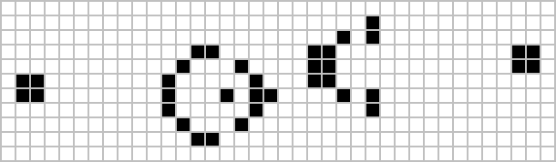
Synchronization through the clock prevents read-out during transitions
A biological clock helps a continuous wavefront pattern the somites (which give rise to vertebrae, etc.)

Slide 59
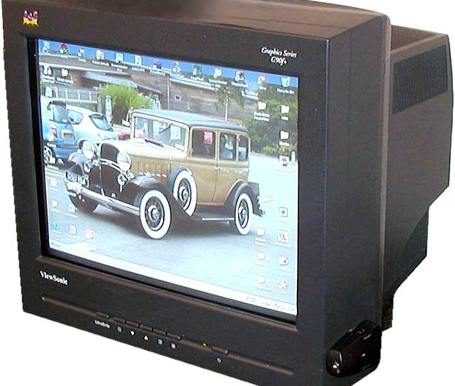
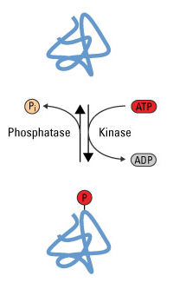
Separation of timescales
What if the input [TF]s changed much faster than gene expression occurred?
This can be achieved if the transcription factors are always present but are modified to become activated. (Post-translational modification is faster than gene expression.)
Unfortunately, this only works for shallow networks. We need to be able to string many NAND gates together.
A CRT monitor

Slide 60
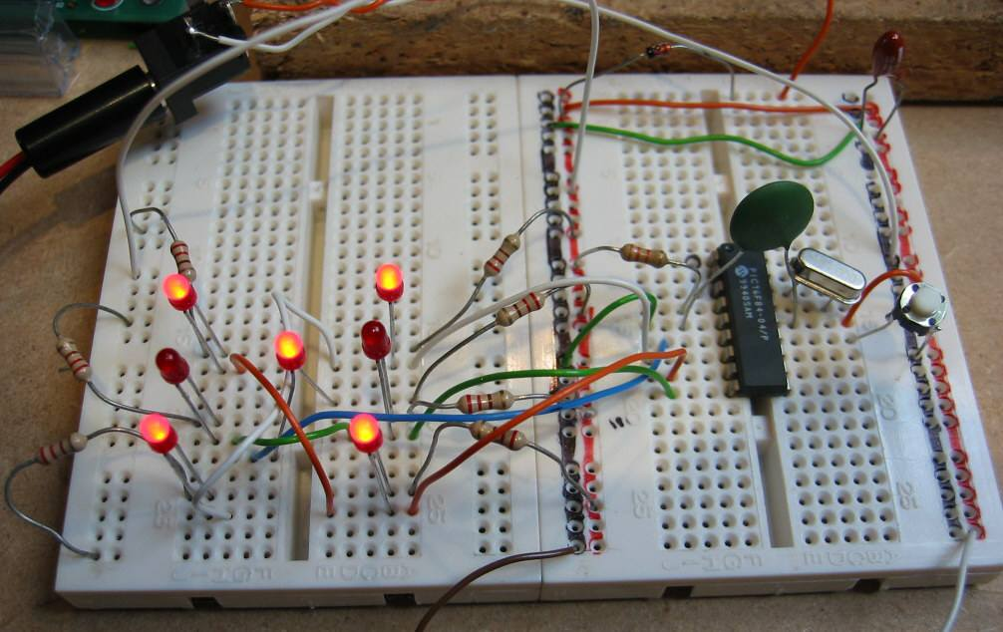
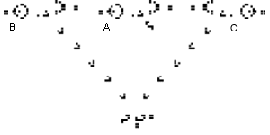
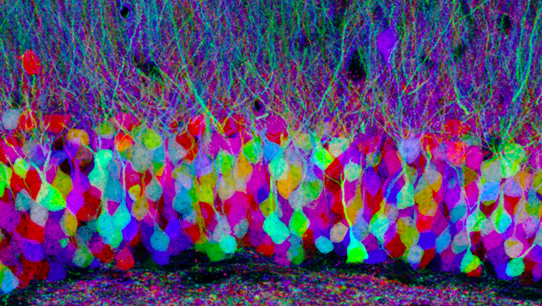
The issue of duplicate parts
Duplicating a TF gene &
using each copy for a different task in the same cell
Notes:
100 billion neurons in brain

Slide 61
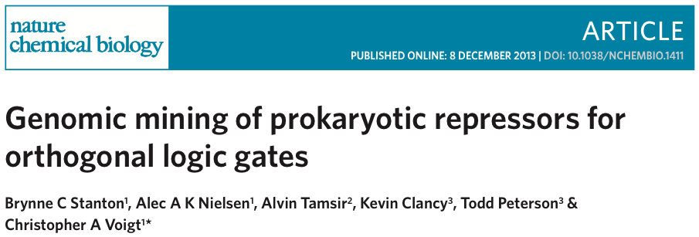
The first discussion paper

